Slide 1
2017 ICCB Beneficiaries Completed & Potential 2018 Beneficiaries

Slide 2
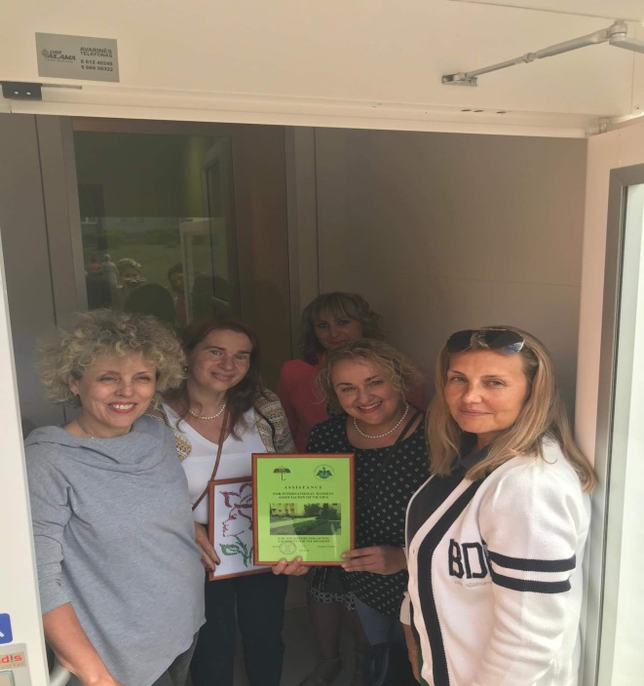
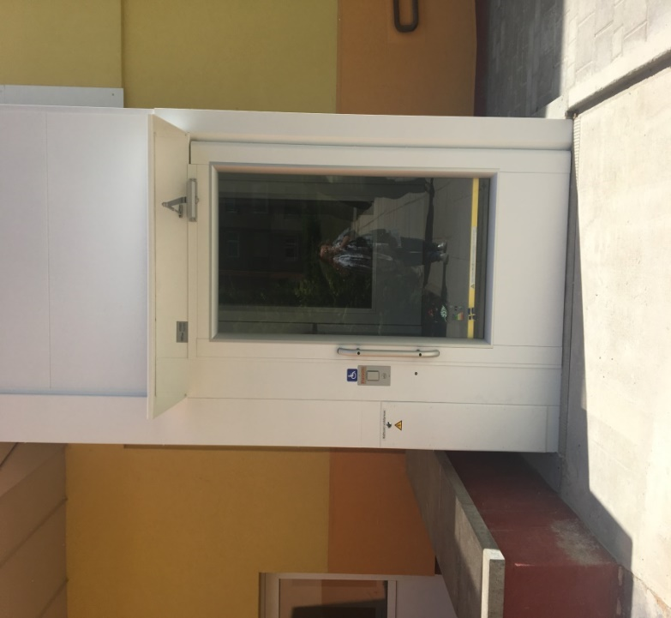
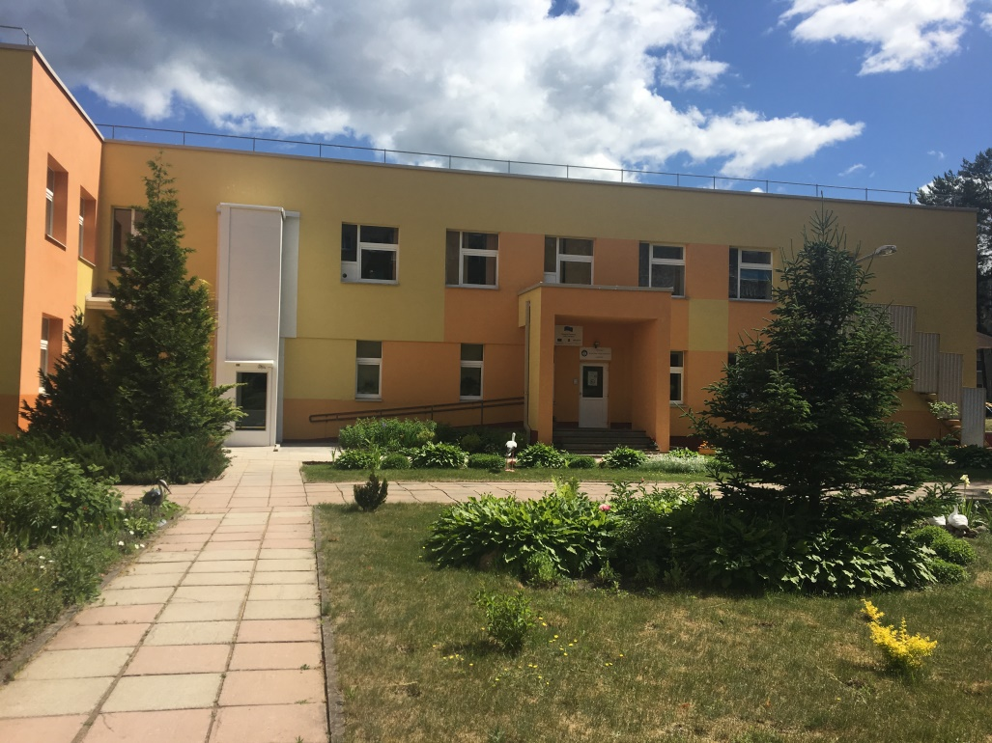
Beneficiaries 2017
Visaginas Children Support Centre, Visaginas
Lift for Disabled

Slide 3
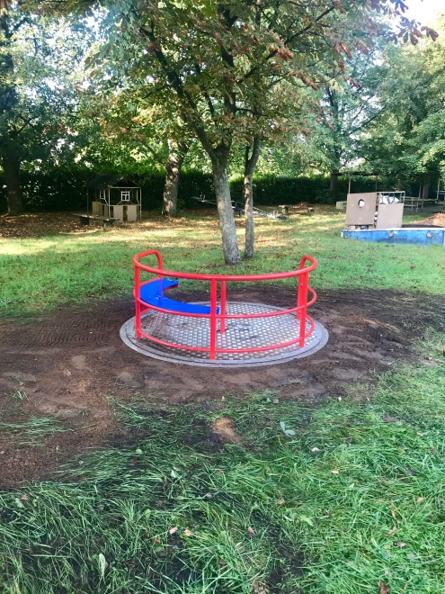
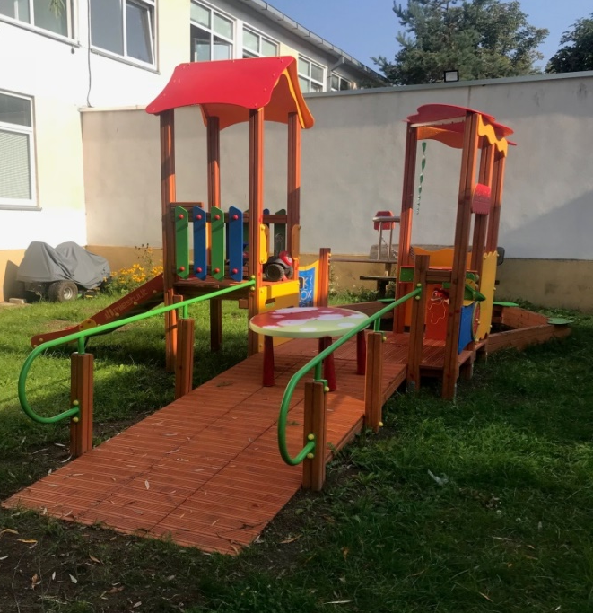
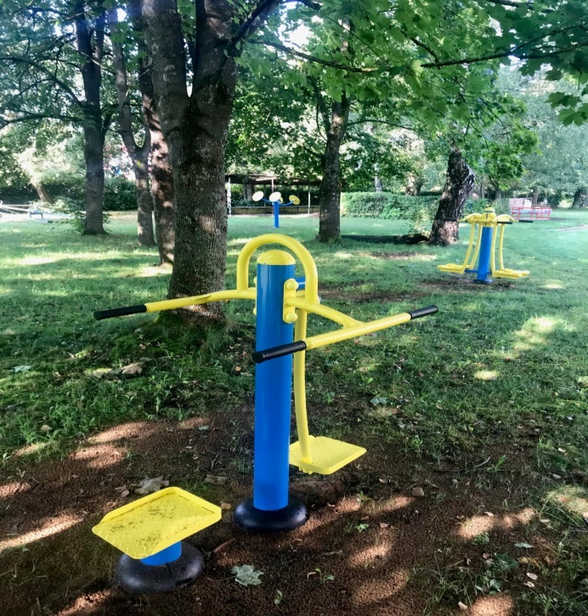
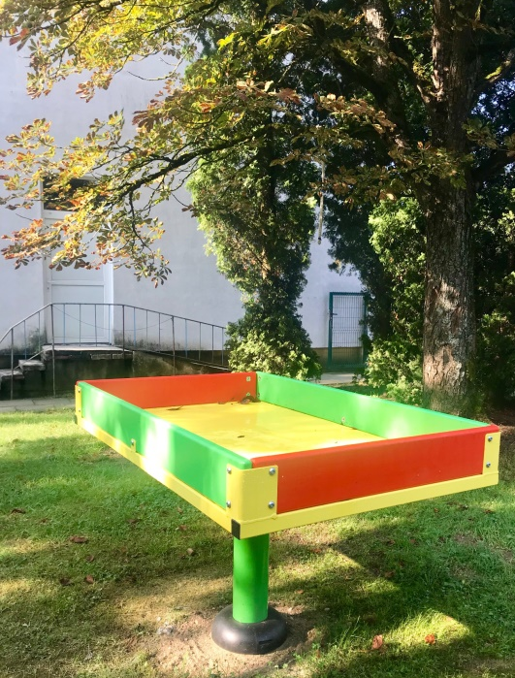
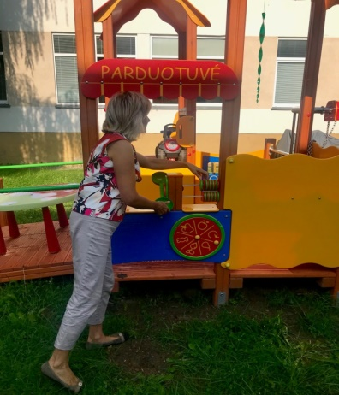
Beneficiaries 2017
“Aidas” Center, Vilnius
Outdoor Play and Sport Ground

Slide 4
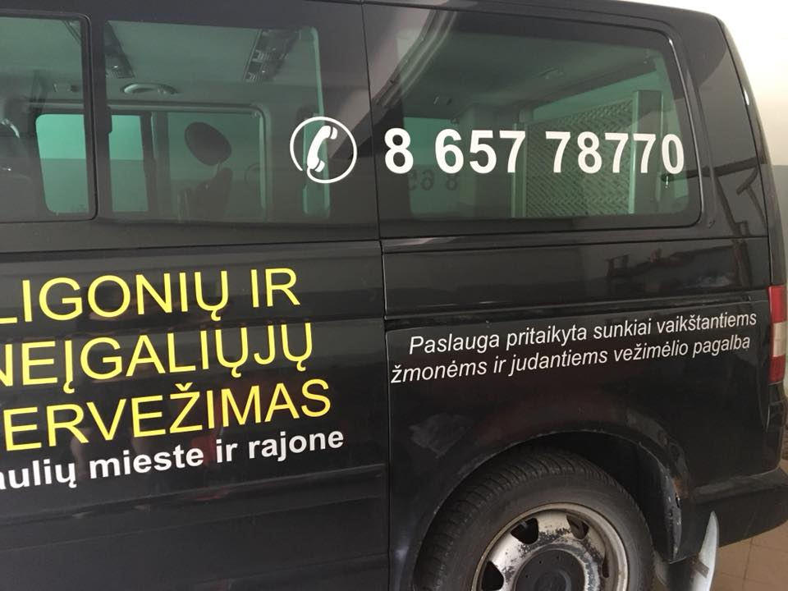
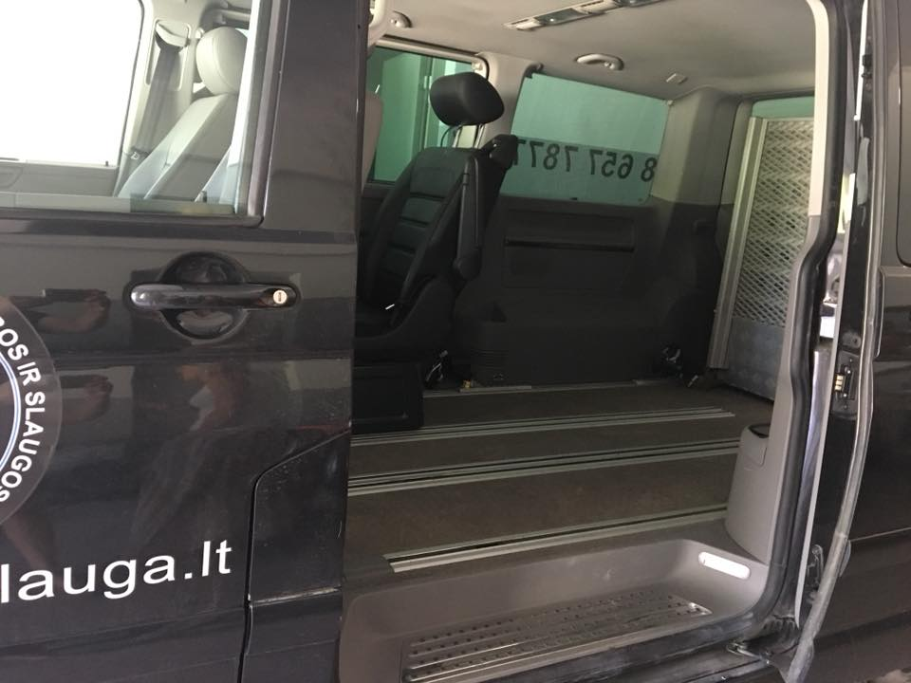
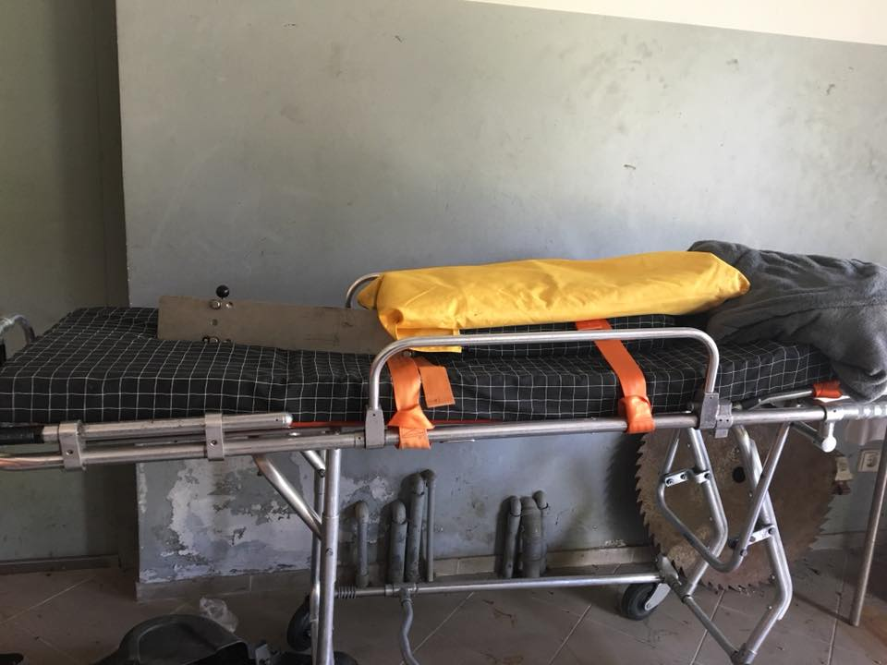
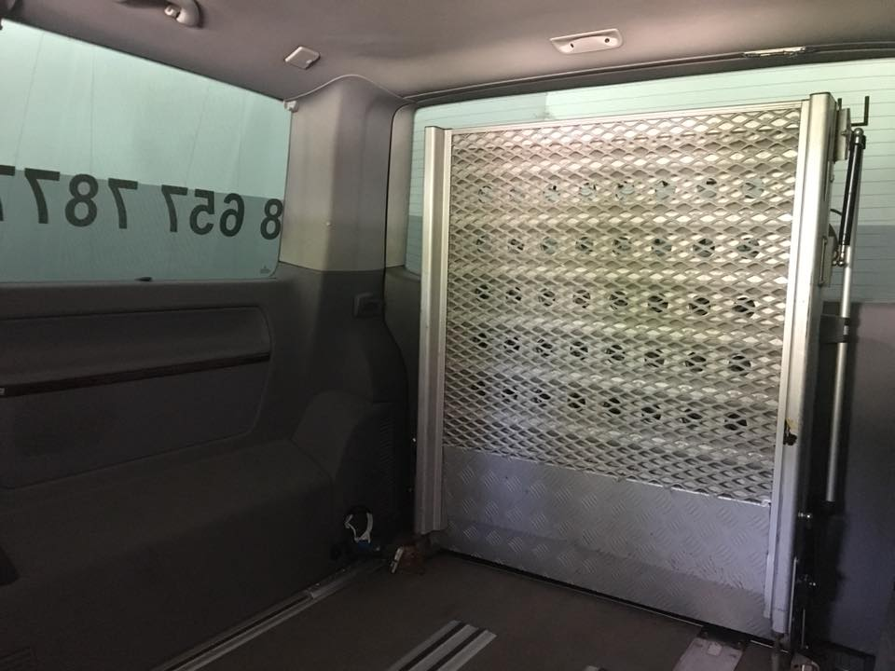
Beneficiaries 2017
Siauliai Center for Palliative Care and Nursing, Siauliai
Disabled transport vehicle

Slide 5
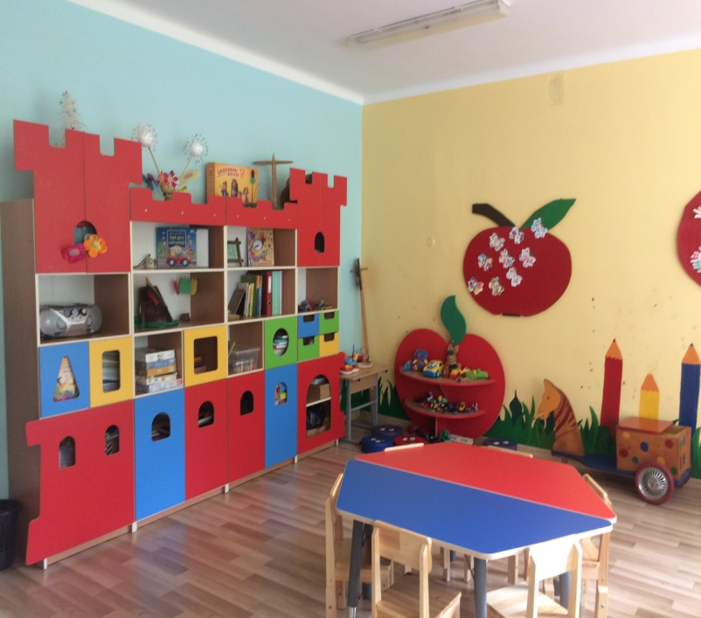
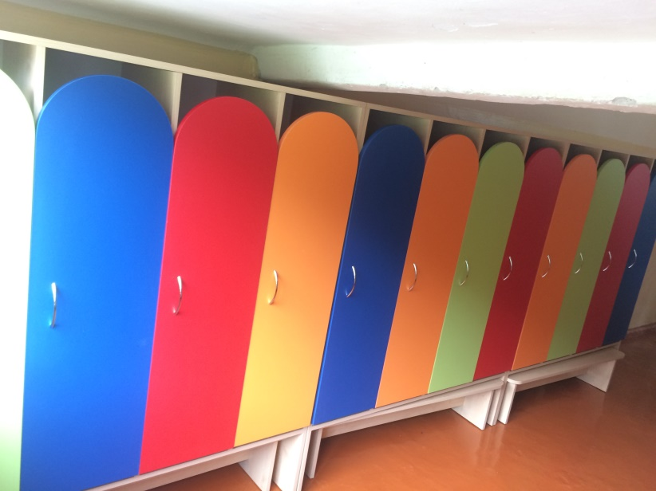
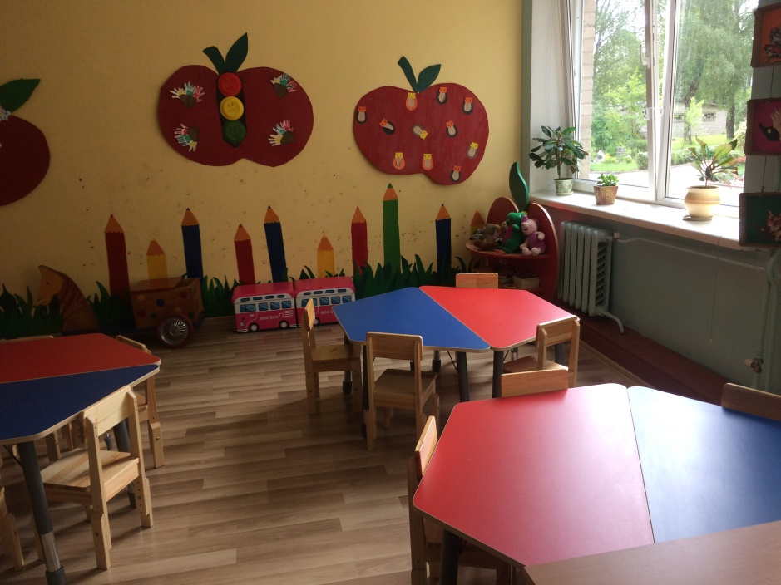
Beneficiaries 2017
Kupiškio r. Alizavos Pagrindinė
Mokykla, Alizava
New floor, adjustable desks, chairs, etc.

Slide 6
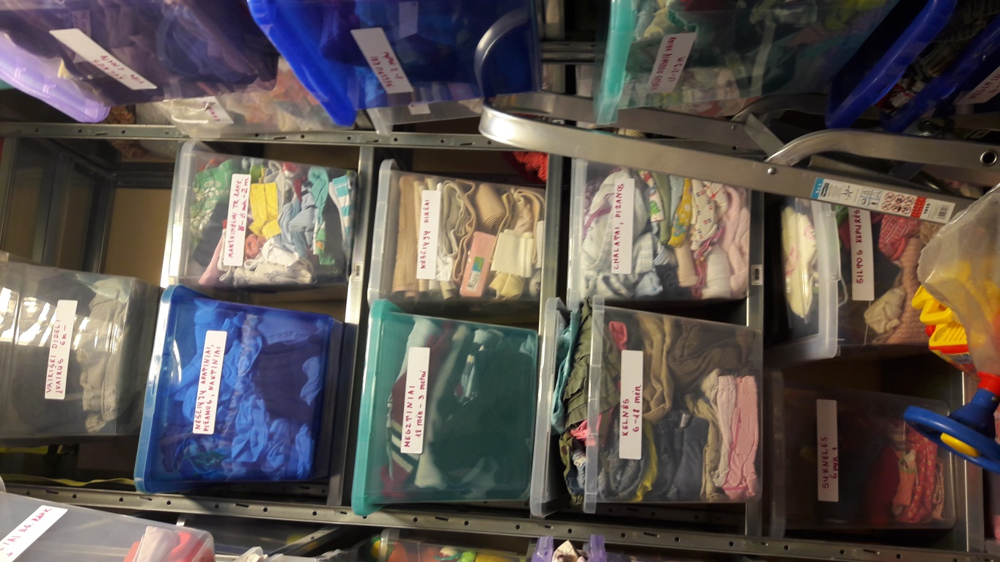
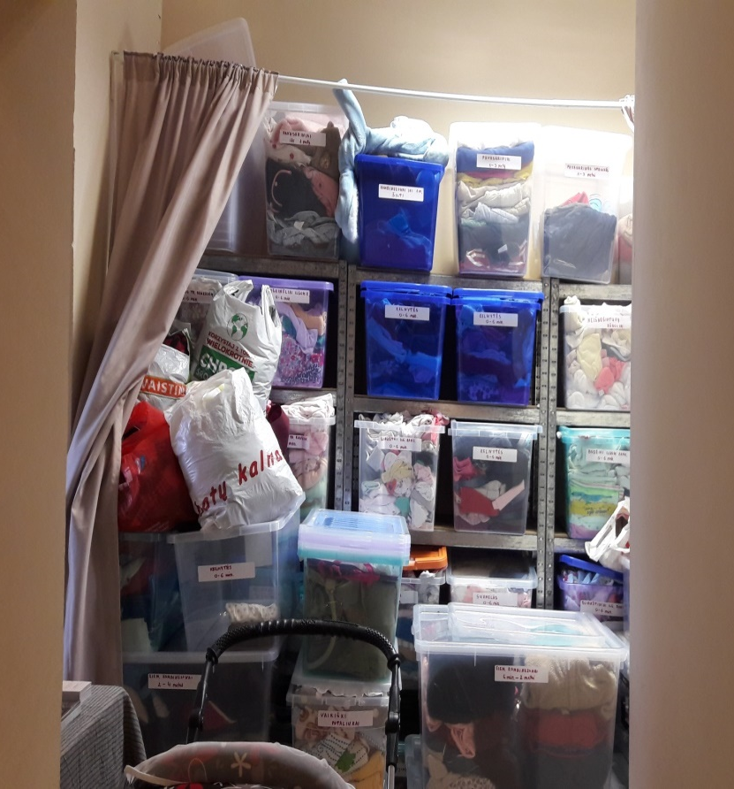
Beneficiaries 2017
Crisis Pregnancy Center, Vilnius
Storage boxes

Slide 7
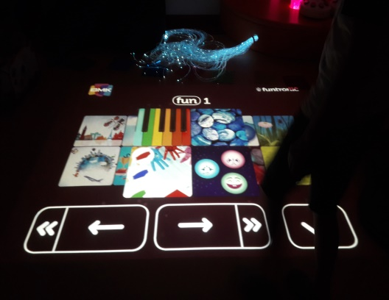
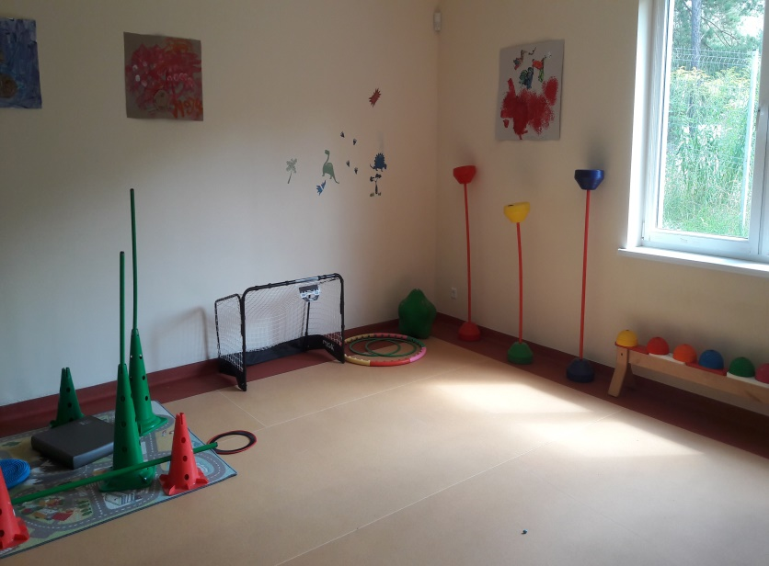
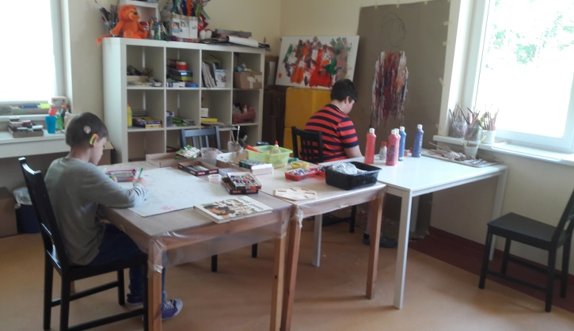
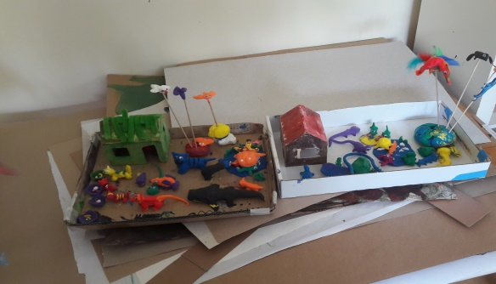
Beneficiaries 2017
Lithuanian Autism Association
“Rain Children”, Vilnius
Educational Tools & Sensory Integration
Equipment

Slide 8
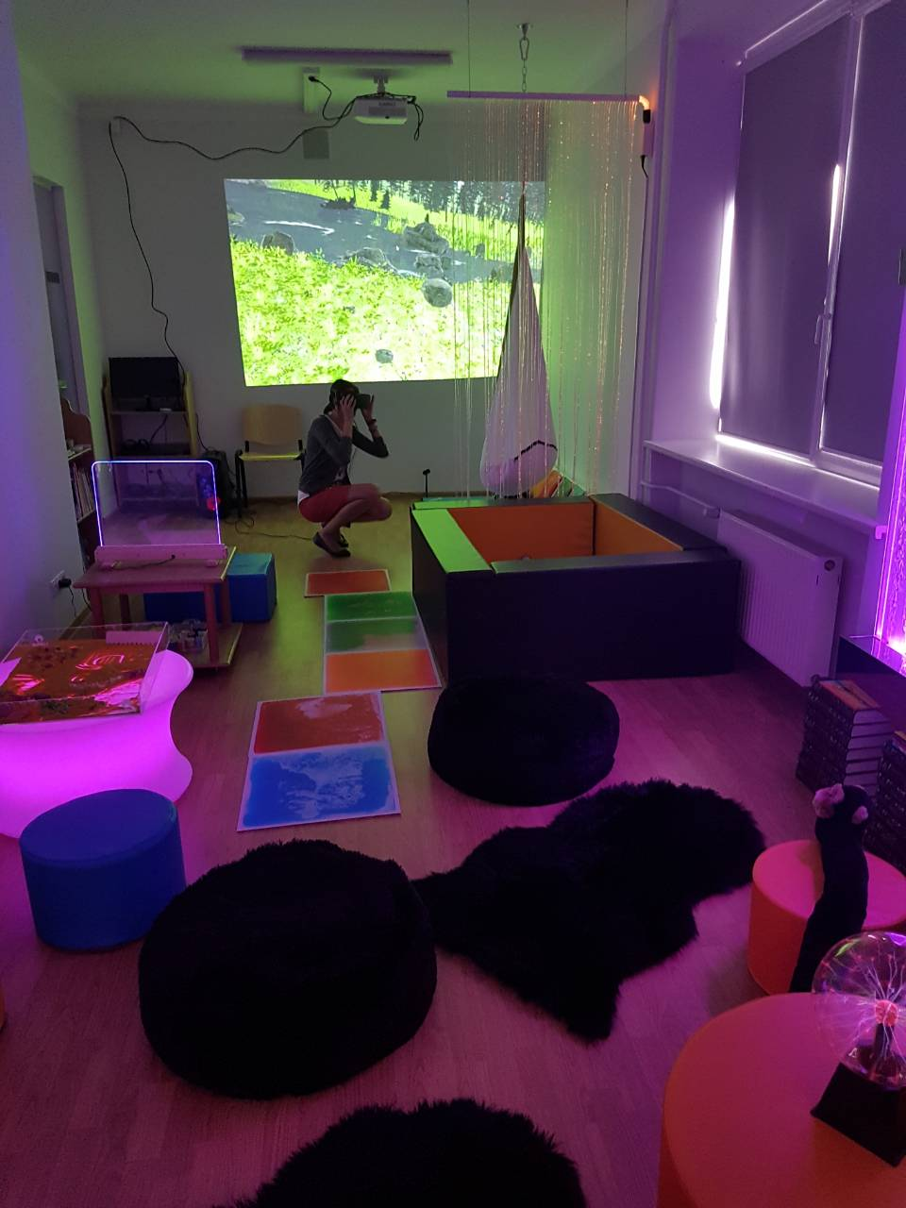
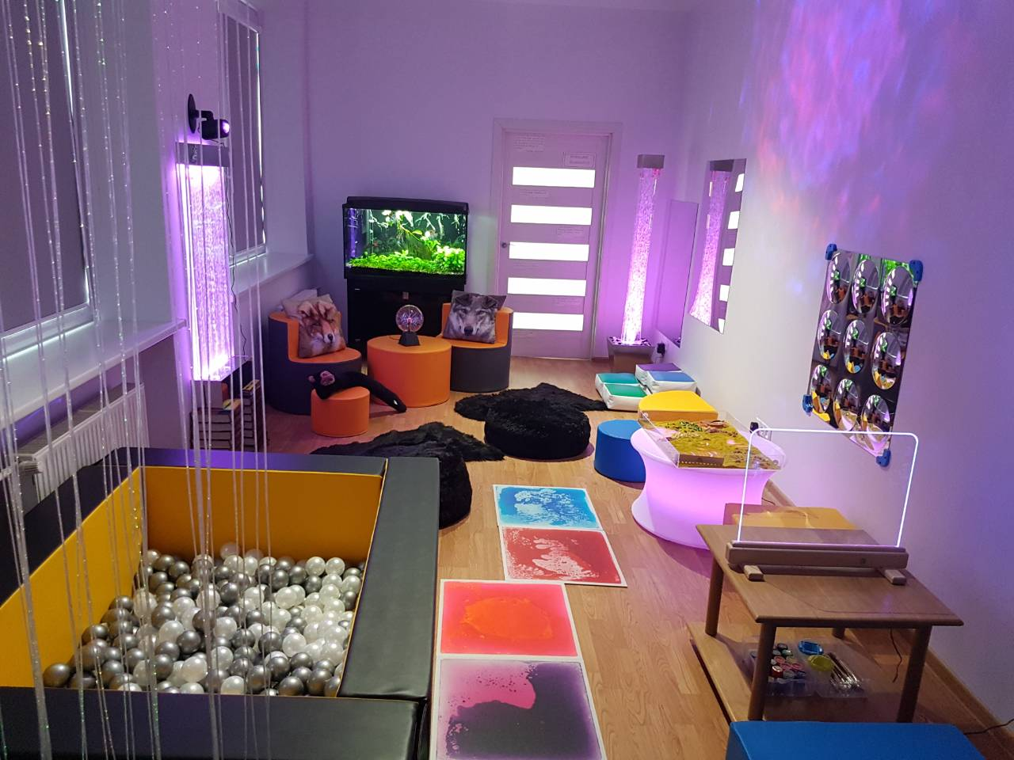
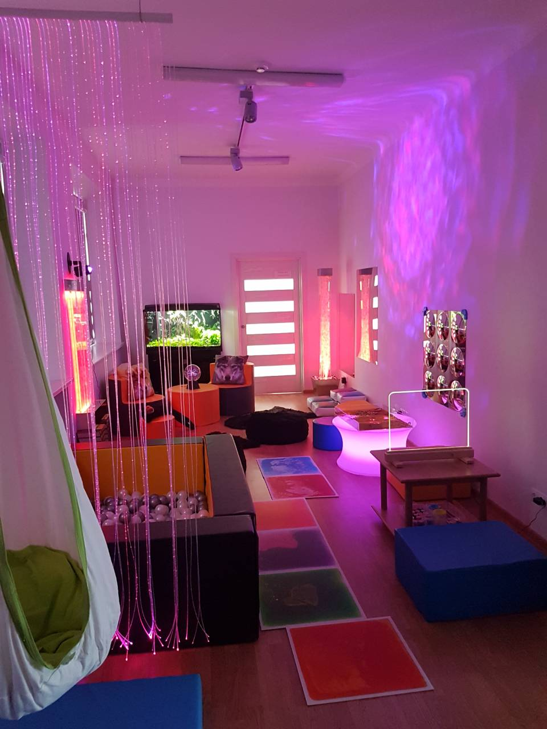
Beneficiaries 2017
Children and Youth Day Center
“Musu Nameliai”, Vilnius
Premises maintenance,
Multi-Sensory Room Equipment

Slide 9
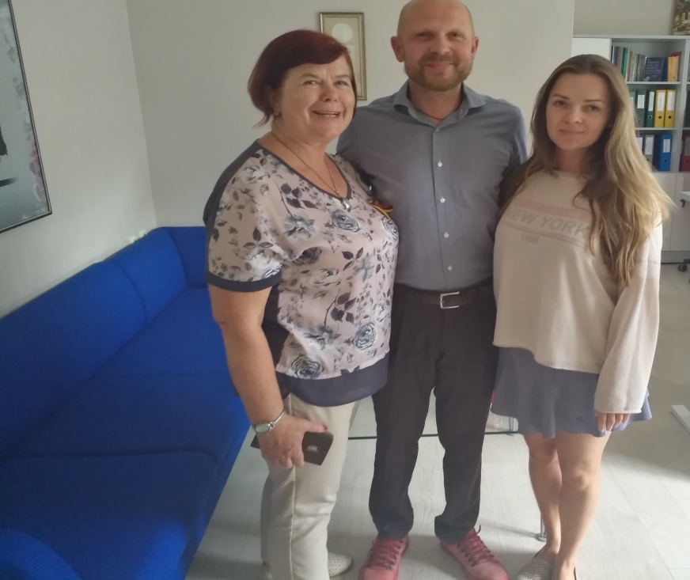
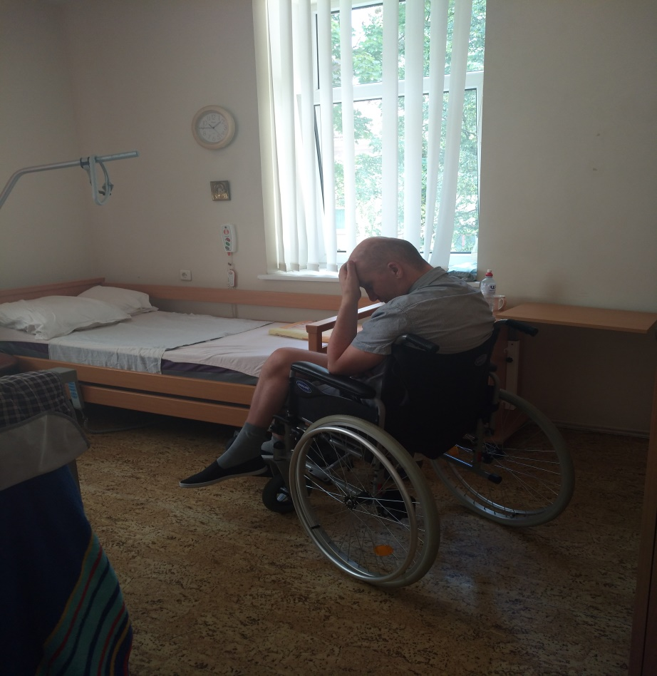
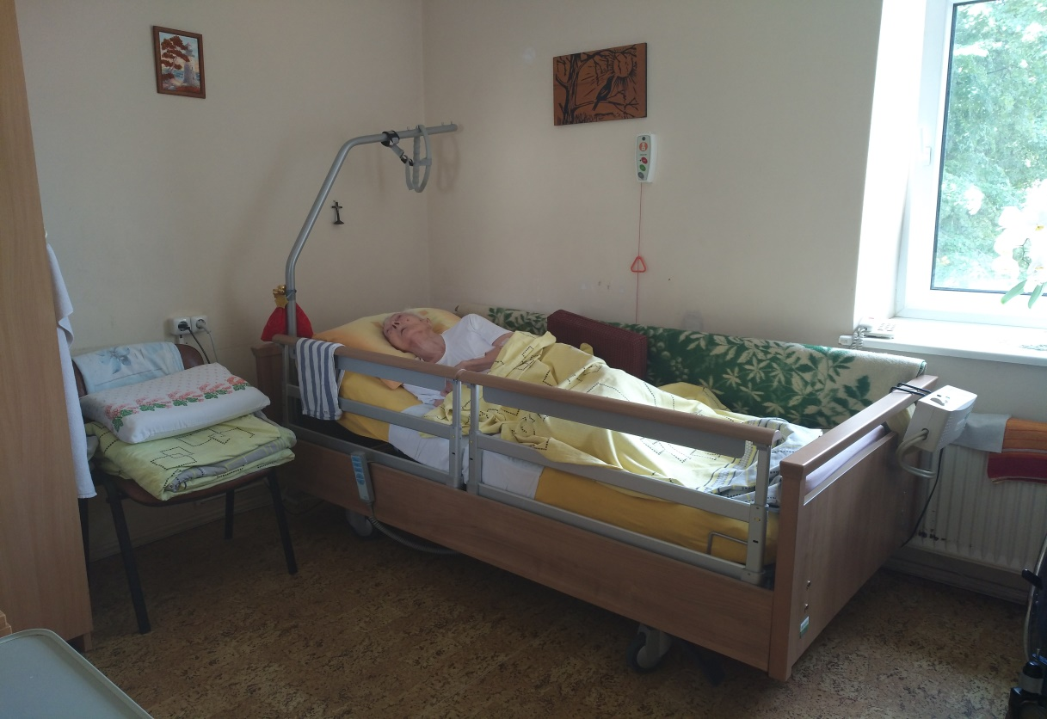
Beneficiaries 2017
Klaipeda City Care Home, Klaipeda
Nursing Beds, Mattresses, Wheelchairs

Slide 10
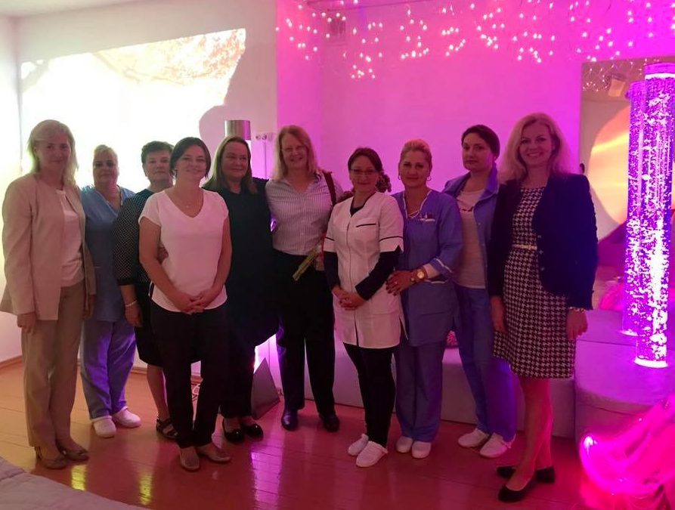
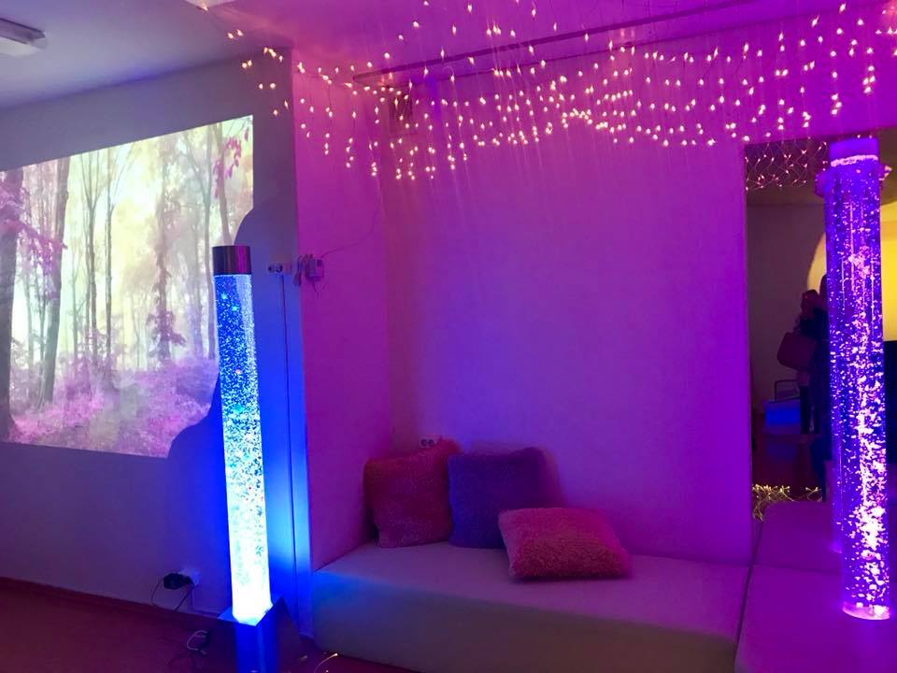
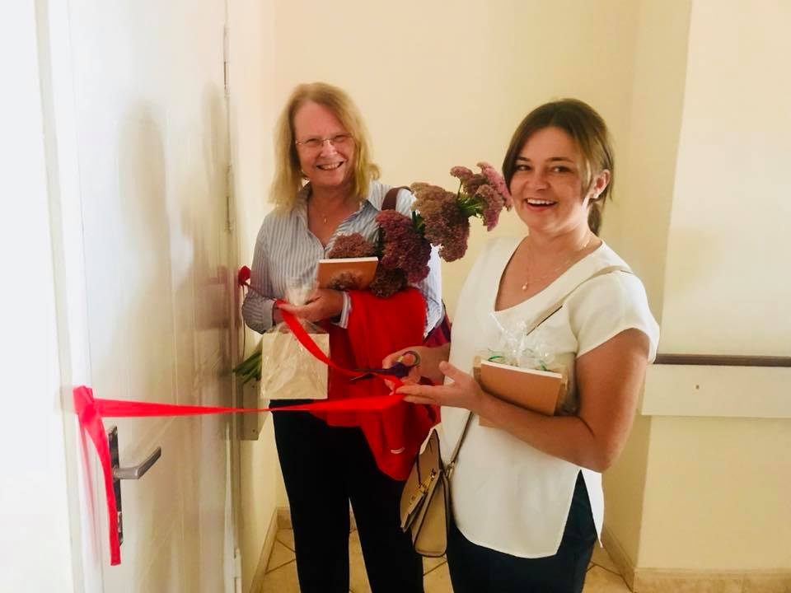
Beneficiaries 2017
Suvalkijos Socialines
Globos Namai, Mariampole
Multi sensory room

Slide 11
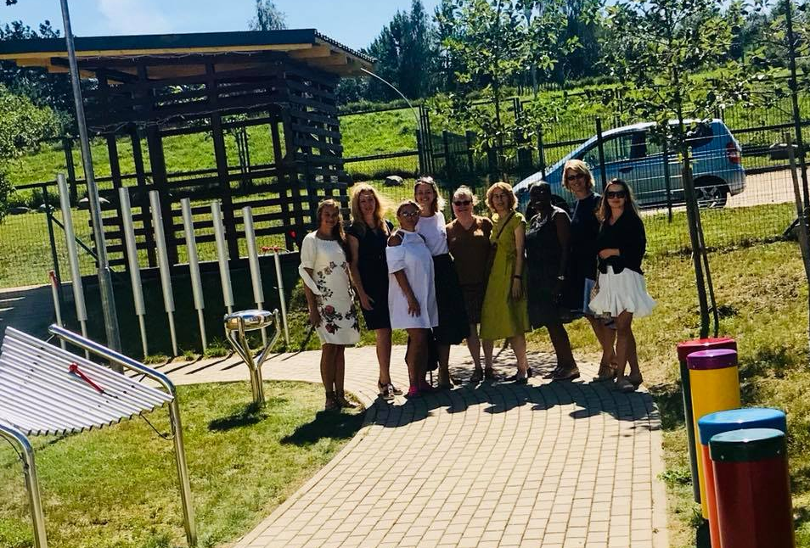
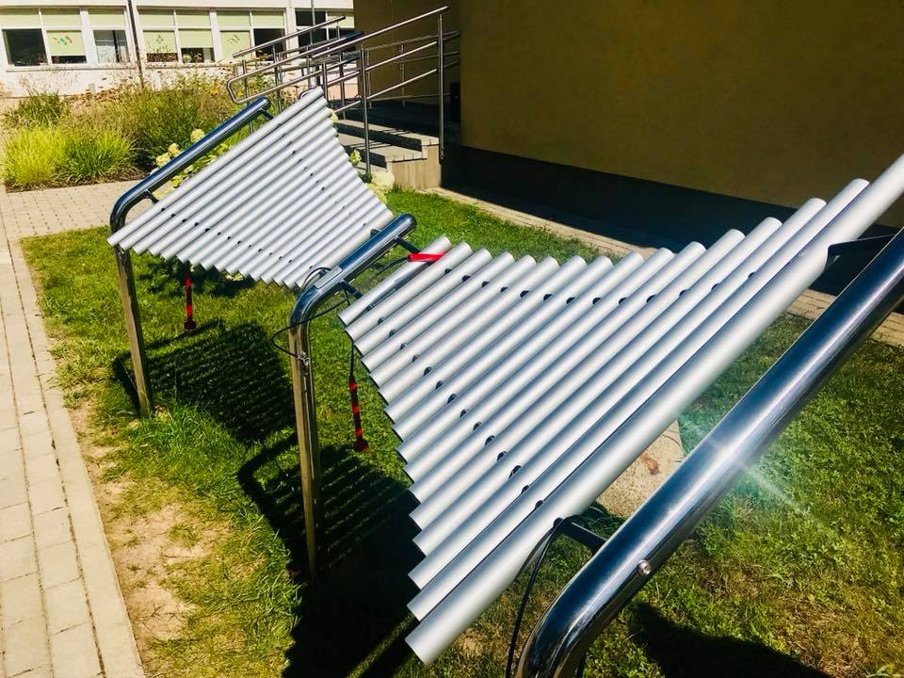
Beneficiaries 2017
Ciauskutis Special Nursery
and Kindergarten, Vilnius
“Path of Music” Outdoor Playground

Slide 12
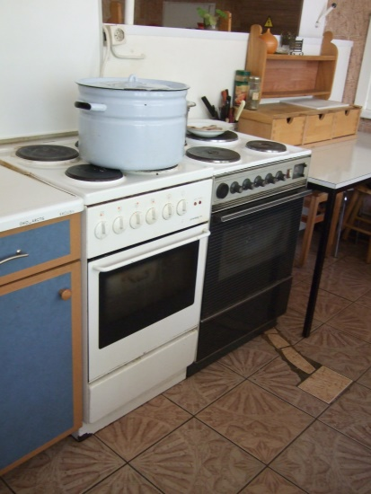
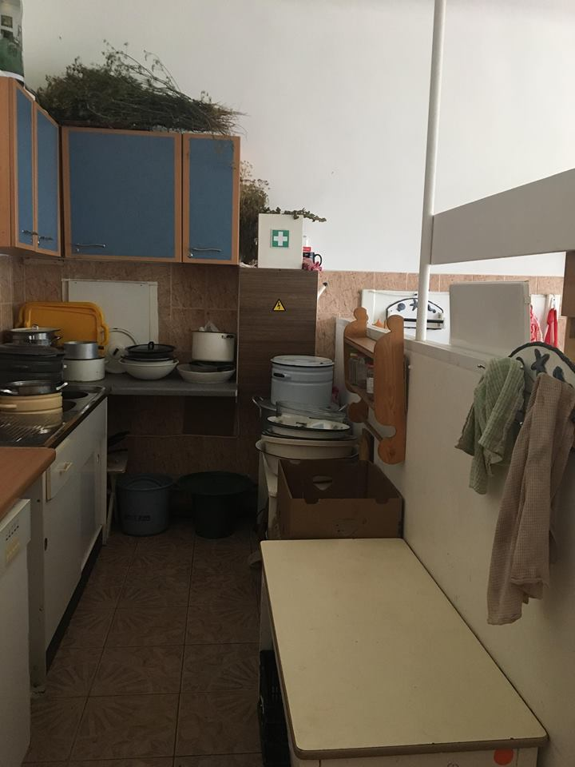
ICCB 2018 potential beneficiaries
Raseiniai Day Center Center for Disabled
- Replace staircase, Sports Ground Equipment
Mother Theresa Family Home, Siauliai
- Kitchen
Renovation

Slide 13
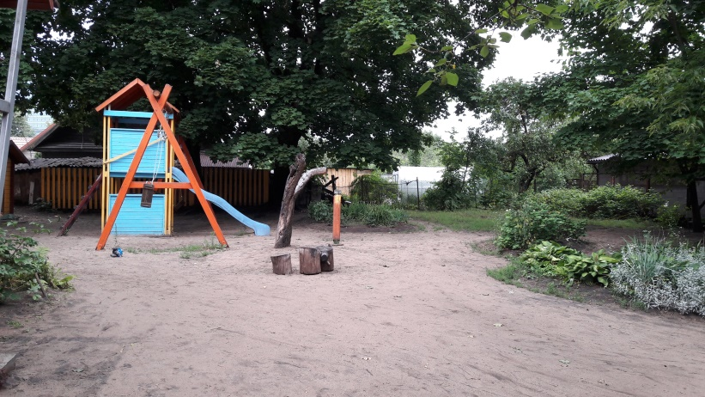
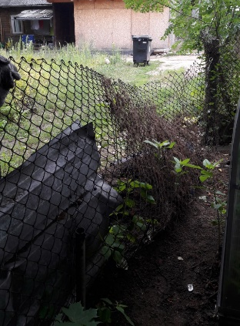
ICCB 2018 potential beneficiaries
Kindergarten Nendre, Vilnius
- Securing and extra illumination to play area
Center for the Blind and Visually Impaired, Vilnius
– Reading Room Renovation

Slide 14
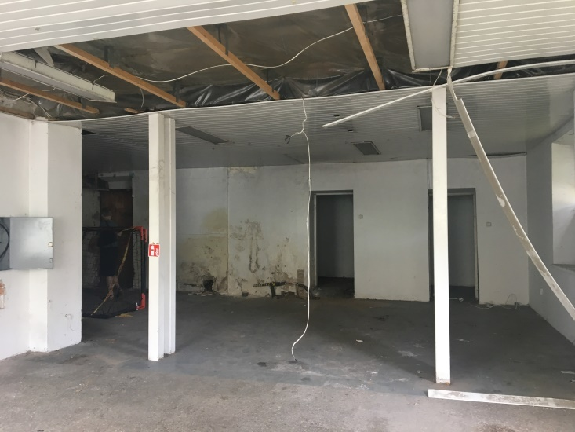
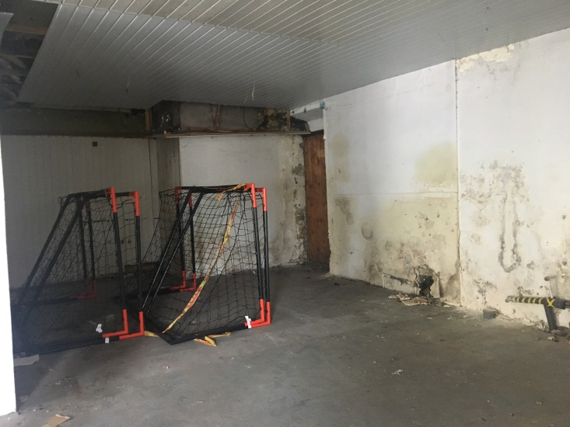
ICCB 2018 potential beneficiaries
Vilnius Social Club for Street Children, Vilnius - Premises Renovation
Vilijampole Social Care Home, Kaunas
- Interactive Educational Room, Outdoor
Playground for children with autism

Slide 15
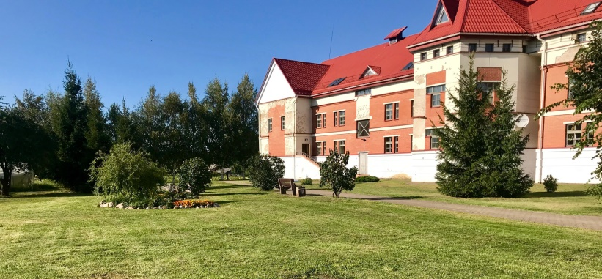
ICCB 2018 potential beneficiaries
Rusne Special School,Kuposkio
- Educational Special Needs Playground
Vilkpedes Hospital, Vilnius
- Mattresses, Bed Sheets

